Slide 1


Natural Language Processing – TP2
Hugo Silva PG50416
Tomás Lima PG50788
Florian Hetzel E10945
Teachers:
José Almeida
Luís Cunha

Slide 2
Procedure
Changed keys form ‘pt’ to ‘en’
Enrich dataset
Find relations
Find categories
Clean JSON
Present in website

Slide 3
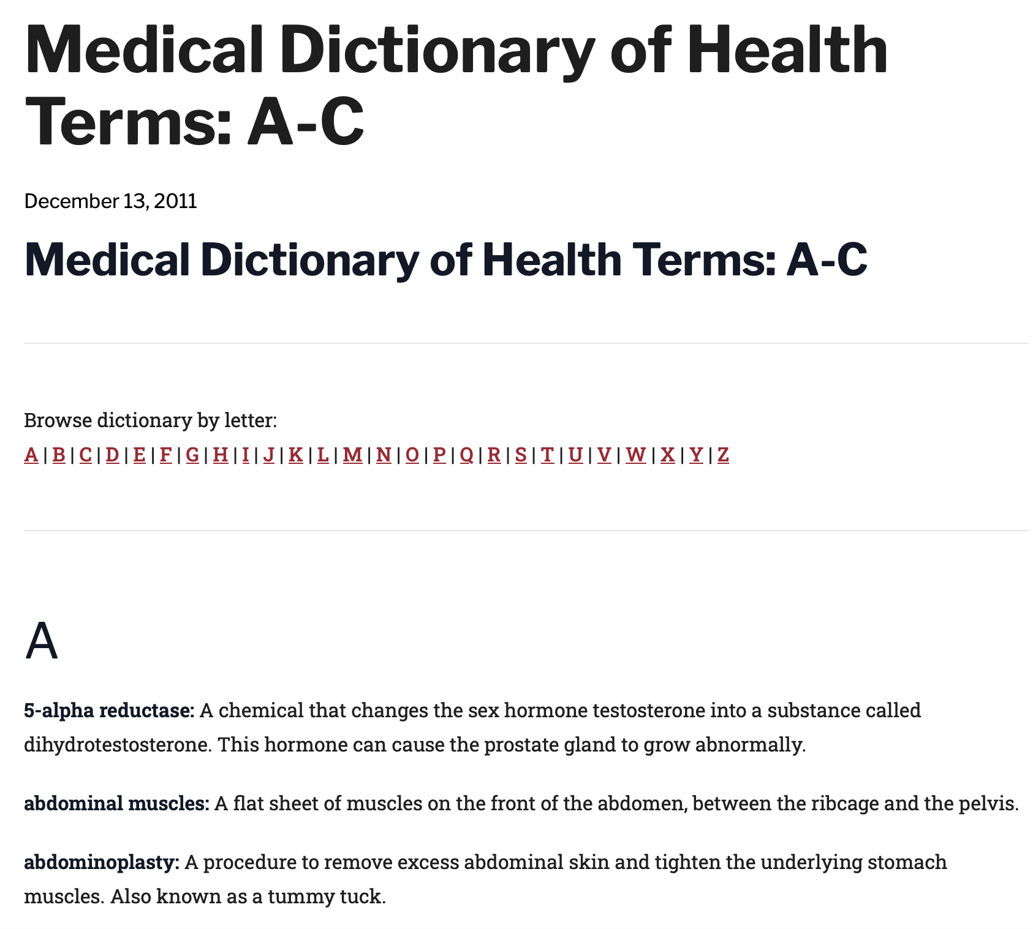

Enrich dataset by web scraping

Slide 4
Enrich dataset by web scraping
1. Getting anchors

Slide 5
Enrich dataset by web scraping
2. Getting terms + desc

Slide 6
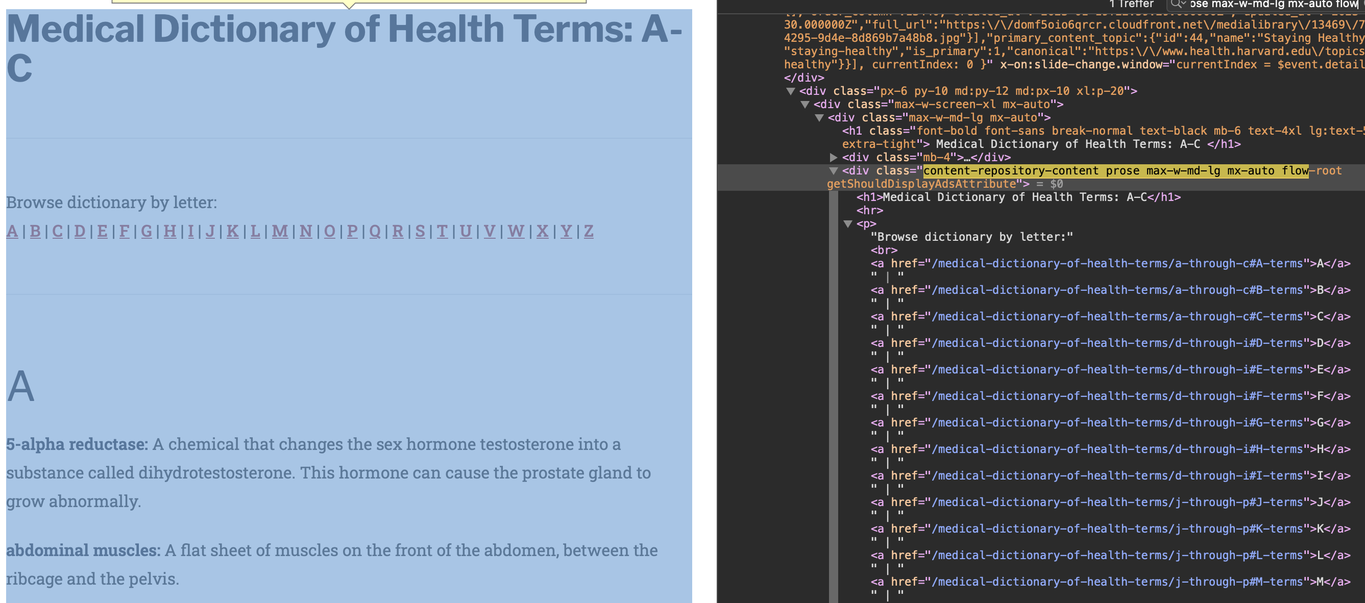
Enrich dataset by web scraping
soup.find_all(class_="content-repository-content prose max-w-md-lg mx-auto flow-root getShouldDisplayAdsAttribute")

Slide 7
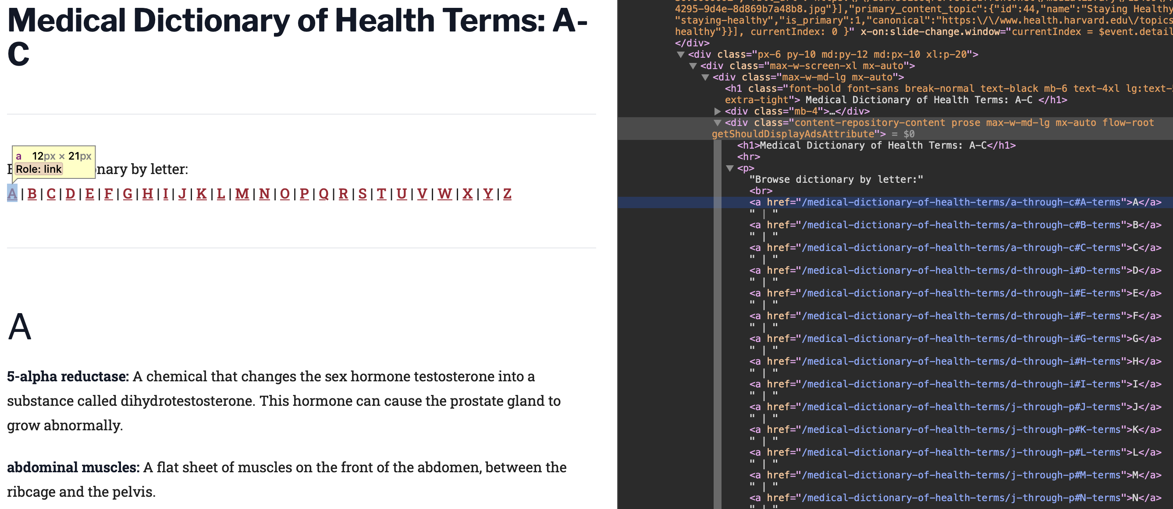
Enrich dataset by web scraping
anchors = [anchor['href'] for anchor in soup_.find_all('a')]

Slide 8
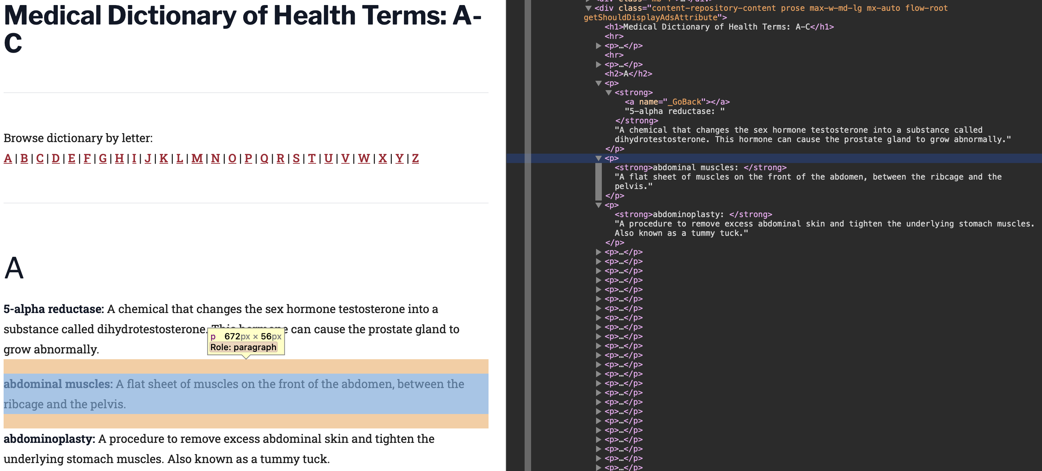
Enrich dataset by web scraping
body_html.find_all('p‘) -> get text of each p -> .split(‘:‘)

Slide 9
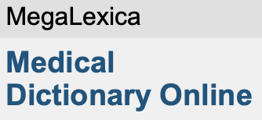

Enrich dataset by web scraping
Added 28.471 terms
Added 2.042 terms
Added 12.326 terms

Slide 10
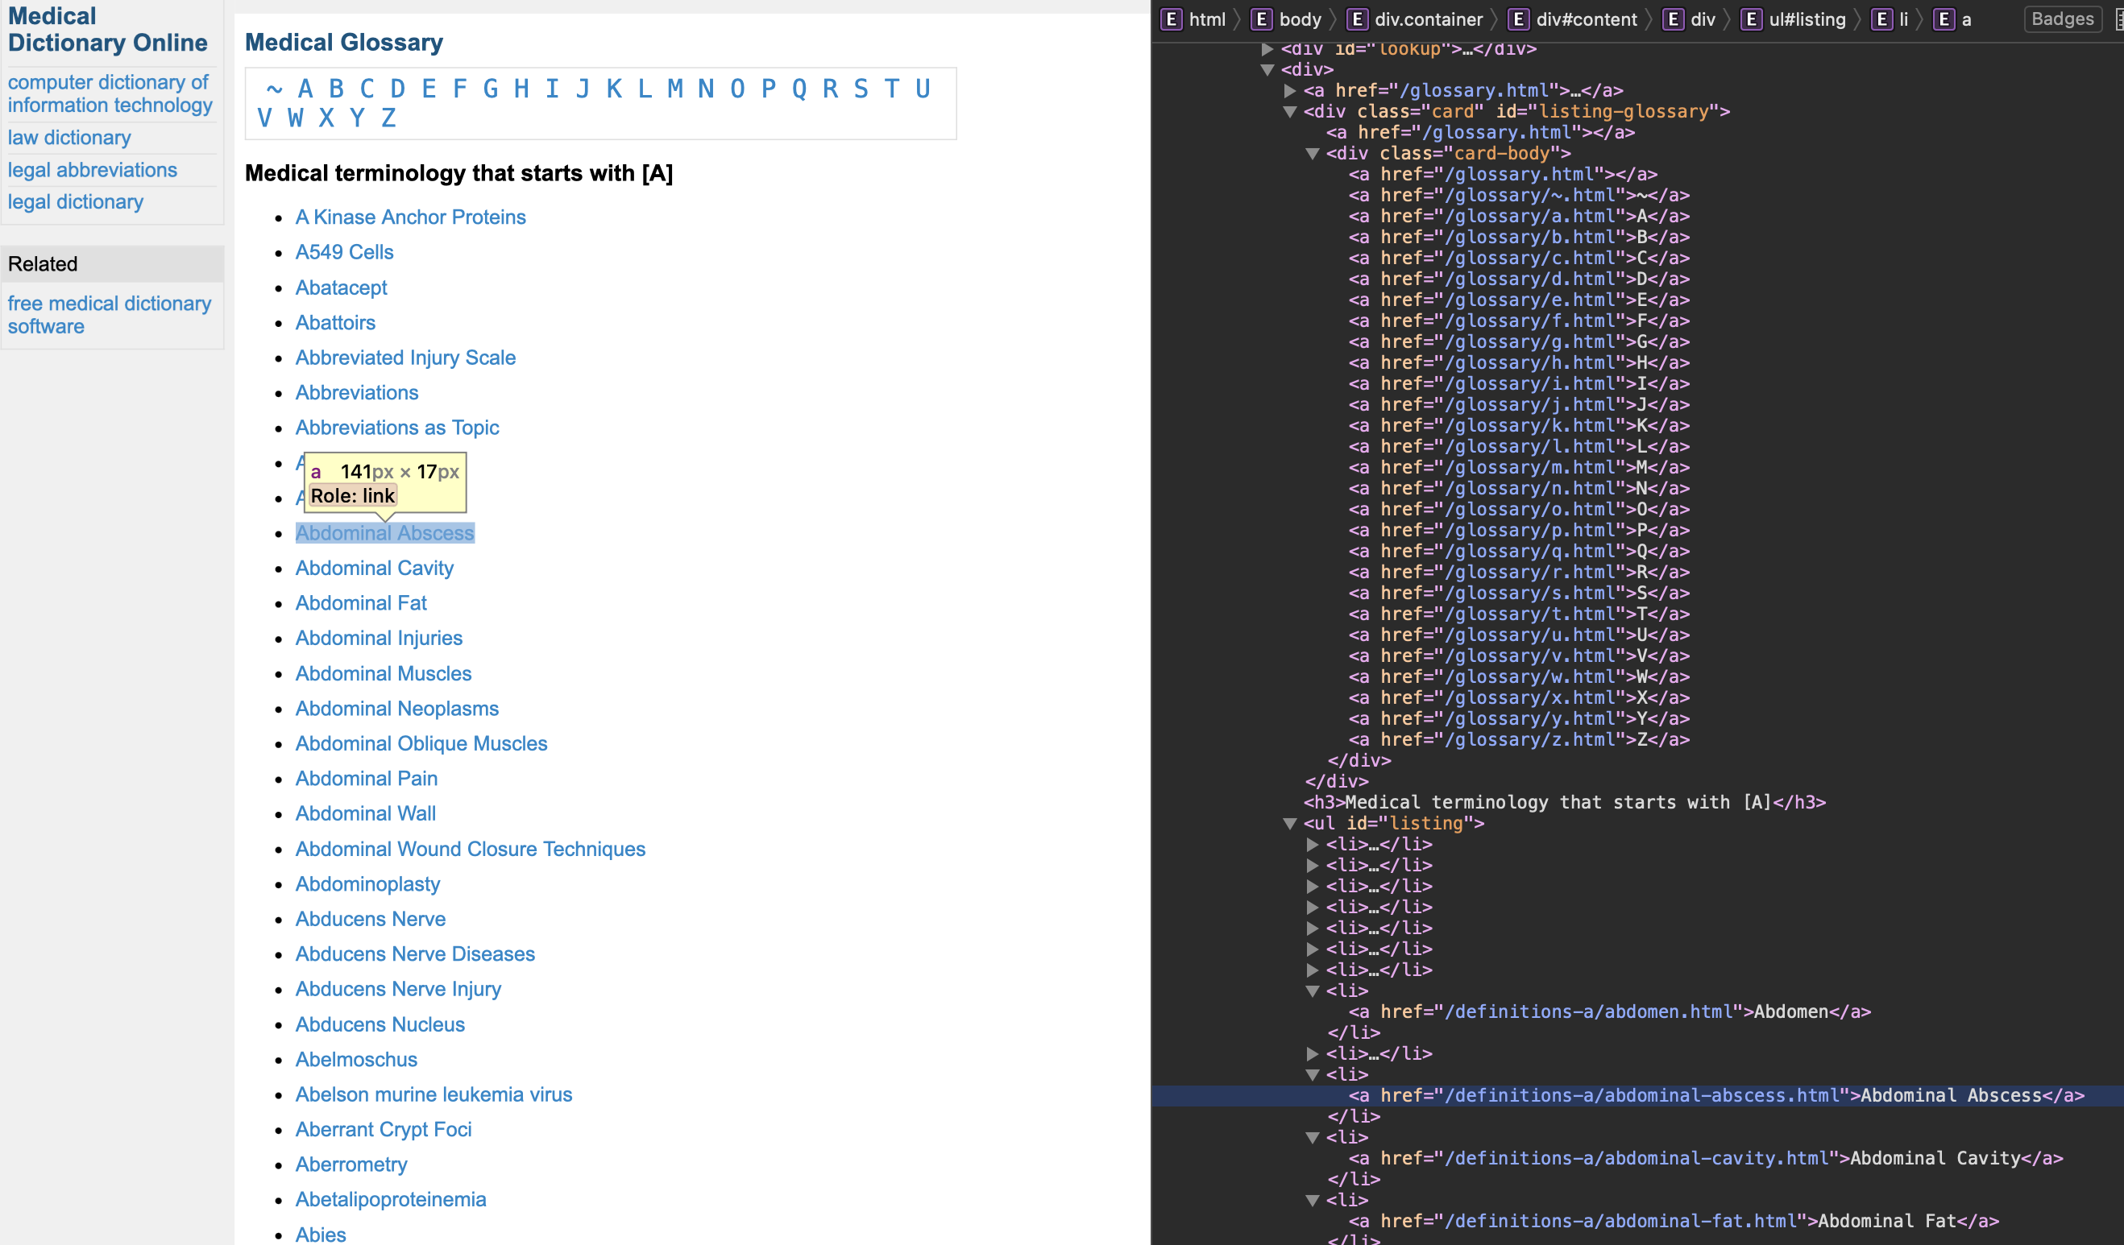
Enrich dataset by web scraping
body = page_html.find_all('li')
termlinks = [url_socket + termlink.a['href'] for termlink in body]

Slide 11
Finding relations
Approaches:
Web scraping
Description and Term Analysis

Slide 12
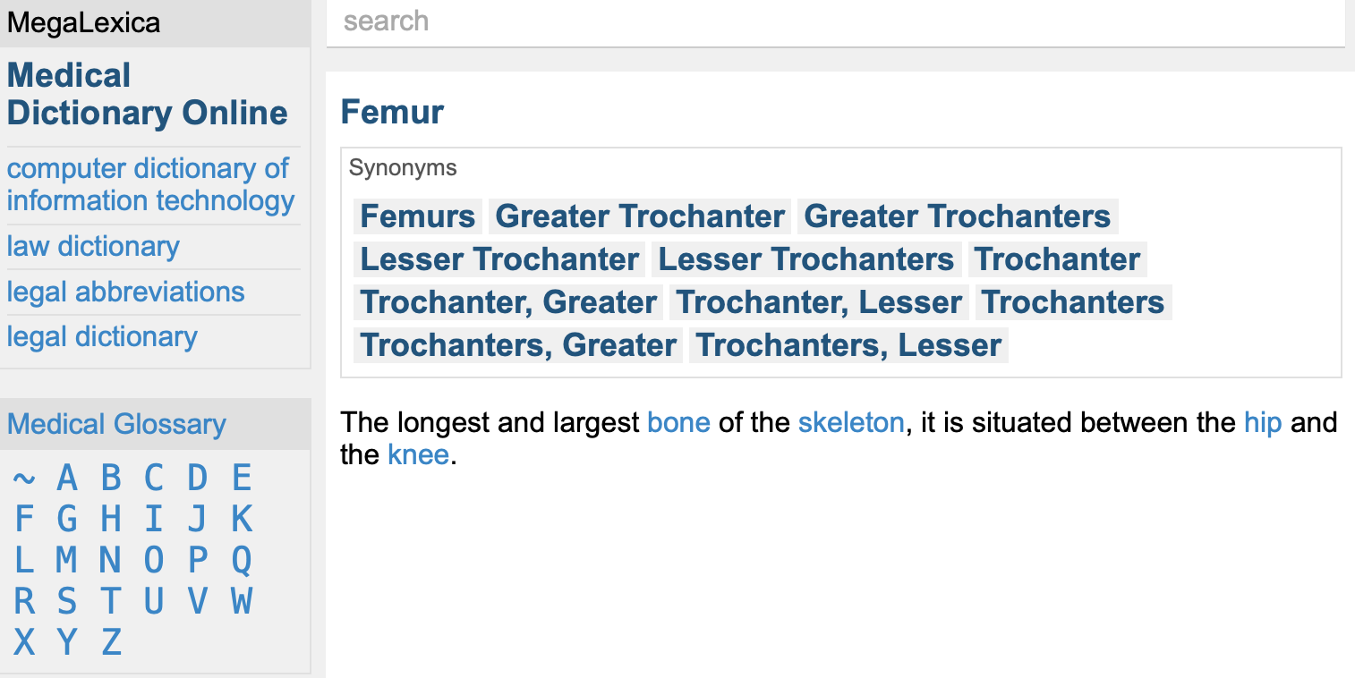
Finding relations with Web scraping

Slide 13
Finding relations by analyzing the descriptions and terms (using spacy)
For descriptions:
Find nouns and adjectives using spacy
Check if these are in the database
Add to list of relations
for description in descriptions:
doc = nlp(description)
for token in doc:
if token.pos_ == "NOUN" or token.pos_ == "ADJ":
nouns.append(token.text.lower())

Slide 14
Finding relations by analyzing the descriptions and terms (using spacy)
For terms:
Terms that contain other terms are likely to be related:
"femur head" ←→ "femur"
"parkinson disease" ←→ "disease"
"paranasal sinus siseases" ←→ "paranasal sinus"
…

Slide 15
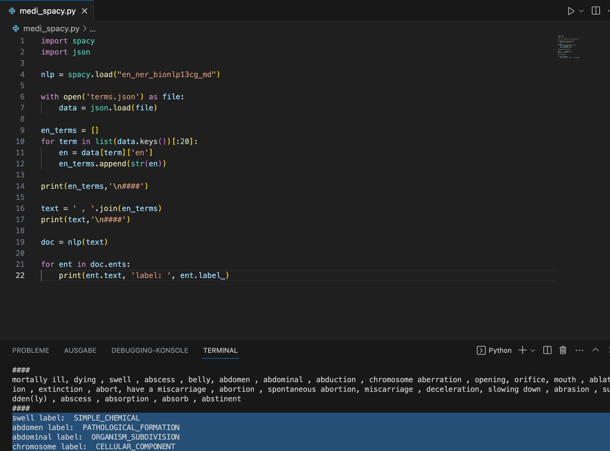
Finding categories with Spacy
SciSpacy modul for biomedical texts

Slide 16
Finding categories with Spacy
Not successful

Slide 17
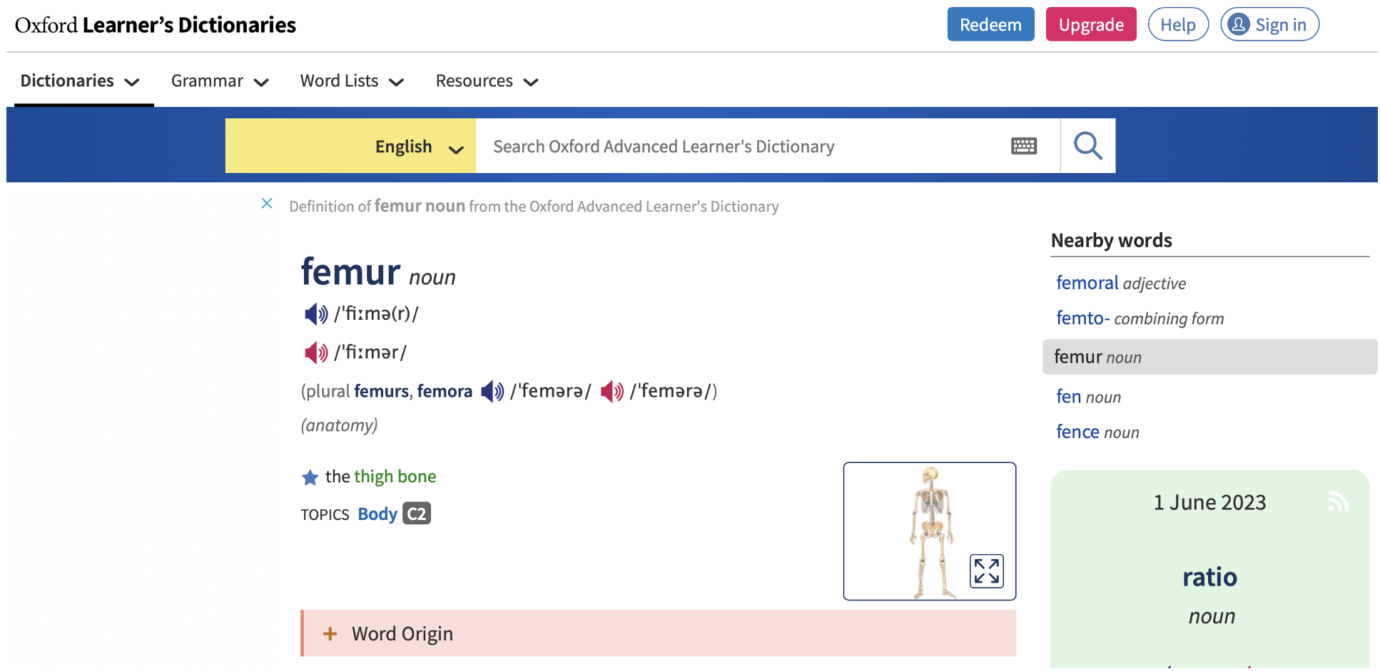
Finding categories with Web scraping
link = f'https://www.oxfordlearnersdictionaries.com/definition/english/{term_en}?q={term_en}'

Slide 18
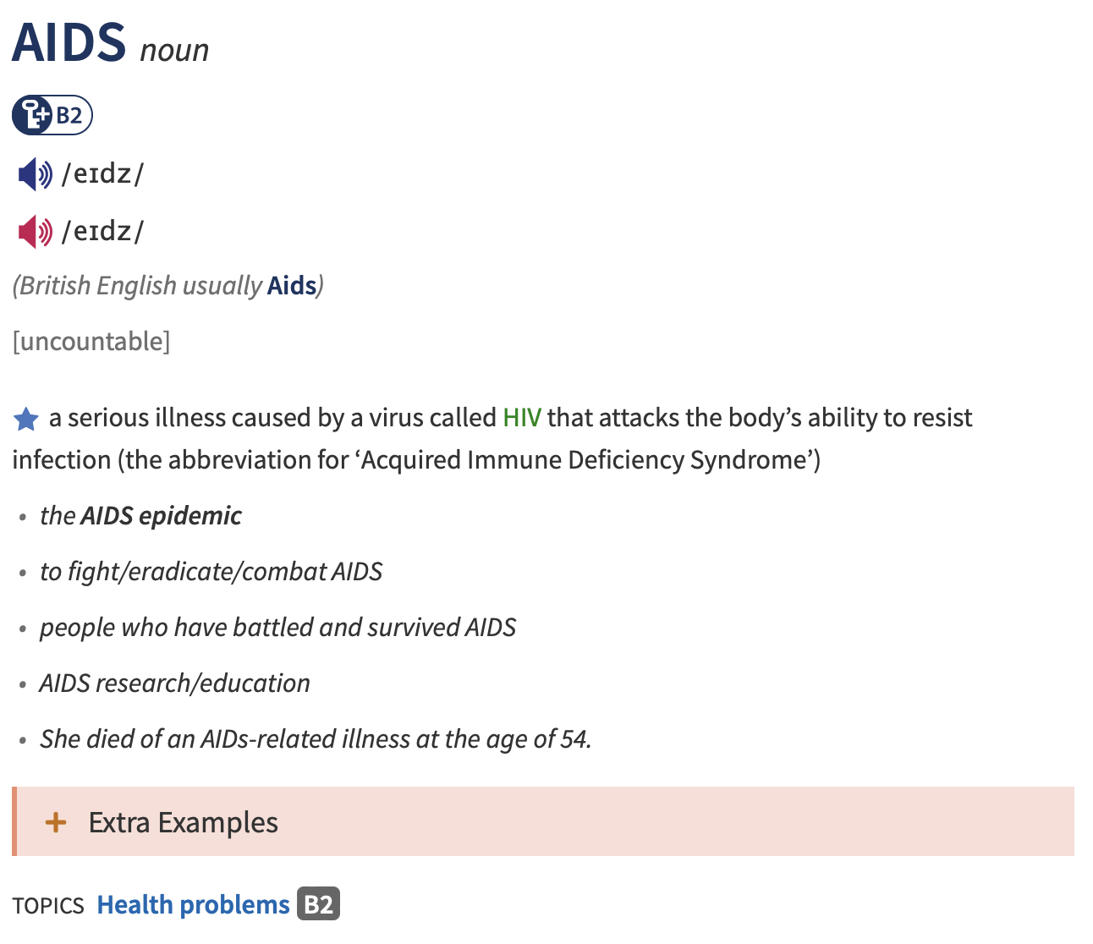
Finding categories with Web scraping

Slide 19
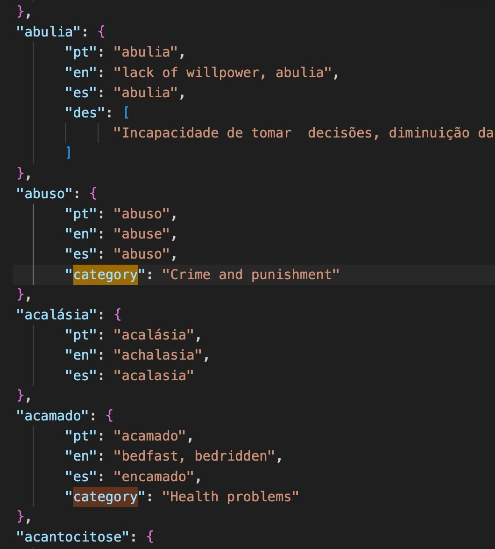
Finding categories with Web scraping
Not successful

Slide 20
Cleaning JSON
Data from different sources → different spelling
Actions against:
Lower all terms: Femur → femur
Merge duplicates

Slide 21
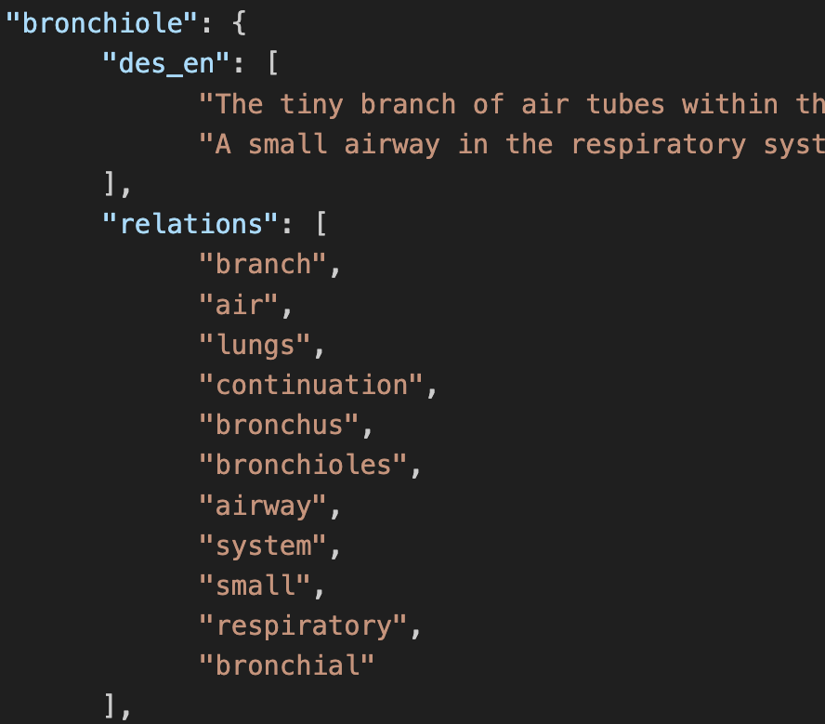
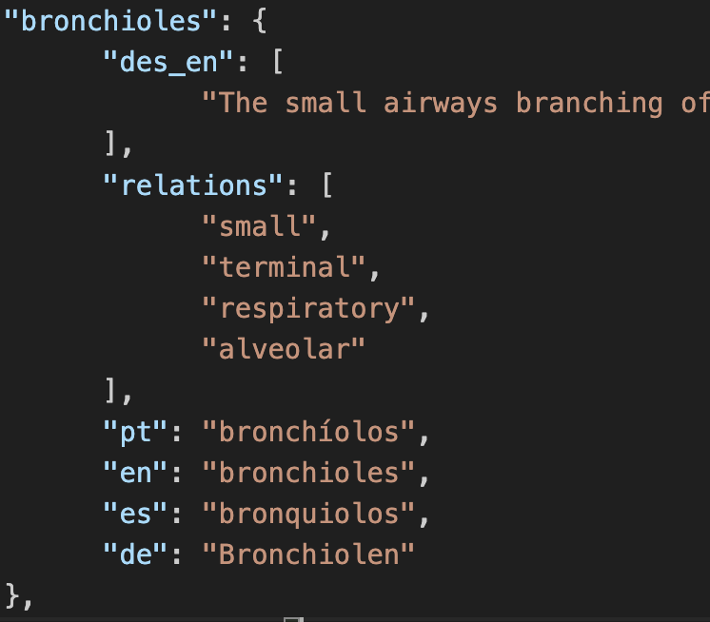
Cleaning JSON
Data from different sources → different spelling
Actions against:
Lower all terms: Femur → femur
Merge duplicates
Merge terms by lemma (using Spacy)

Slide 22
Clean JSON Merging terms by lemma
Problem:
AIDS
.lower()
aids
spacy
aid
Not successful

Slide 23
Natural Language Processing – TP2
Florian Hetzel E10945
Hugo Silva PG50416
Tomás Lima PG50788
Teachers:
José Almeida
Luís Cunha

